Slide 1
Exploring creative alternatives for collecting student voice for curriculum Development
Dr Rose Thompson and Dr Frania Hall
SEDA Curriculum Design Futures, 10th September 2026 Kingston University

Slide 2
Outline
Introducing UAL
Conceptualising the anti-survey
Workshopping 3 quick examples

Slide 3
UAL
Specialist university providing higher education in creative disciplines
Taught academic content, alongside practical application of creative skills
Live project briefs, creative challenges and industry partnerships
Higher than average students and staff body that identify as neurodiverse
Diverse students with variety of creative languages and learning styles

Slide 4
What is the aim?
This is an active participatory workshop building on our ongoing research in this area
It builds on work we have undertaken with students to explore ways to make evaluation more inclusive and meaningful
These approaches are creative in different ways – and avoid surveys
They generate conversations that are authentic and meaningful between students and staff

Slide 5
Our research
Research with students – how do they experience evaluation – what would a meaningful evaluative process look like
Piloting a creative method – Collaging approach - staff feedback on it as an approach
Research with students – exploring creative data collection tools – getting feedback on what it feels like to participate – and co-design of other tools

Slide 6
Criteria developed for evaluation
Research with institutional case studies, UAL staff and students, building on extensive literature review, suggested the following criteria:
Qualitative
Mixed methods
Reflective
Inclusive
Ethical
Accessible
Targeted
Proportionate
Contextual
Actions-oriented
Iterative
Embedded

Slide 7
The survey
Difficulty to get responses - even if robust – if you get no responses you get no data
Self-selection bias - people who fill in surveys
Can’t go into depth – to probe – what it is that works, at the point it works
Survey fatigue – surveys everywhere
Framed usually around text inputs – not always suited to students

Slide 8
Problems with the survey
‘blunt and limited snapshot instruments’ (Spowart et al 2017:361
…generates unreliable and largely irrelevant data with which the sector is trying to respond to increasingly pressing and specific questions about value and impact.’ (Winter et al., 2017:10).
Survey fatigue, not linked to own learning

Slide 9
The Anti-survey - conceptualised as:
Inclusive – more underrepresented groups, wider range of voices
Authentic student voices - ie on their own terms, in their own creative language
Meaningful for both staff and students – developing learning literacy together
Richer, reflective moments– spaces for learning and partnership
Robust
Creative
Supportive, participatory and embedded
Meets key criteria listed from research

Slide 10
Qualities of the anti-survey
Authentic​
Robust​
Creative​
Inclusive​
Participatory​
Supportive​
Meaningful​
Reflective

Slide 11
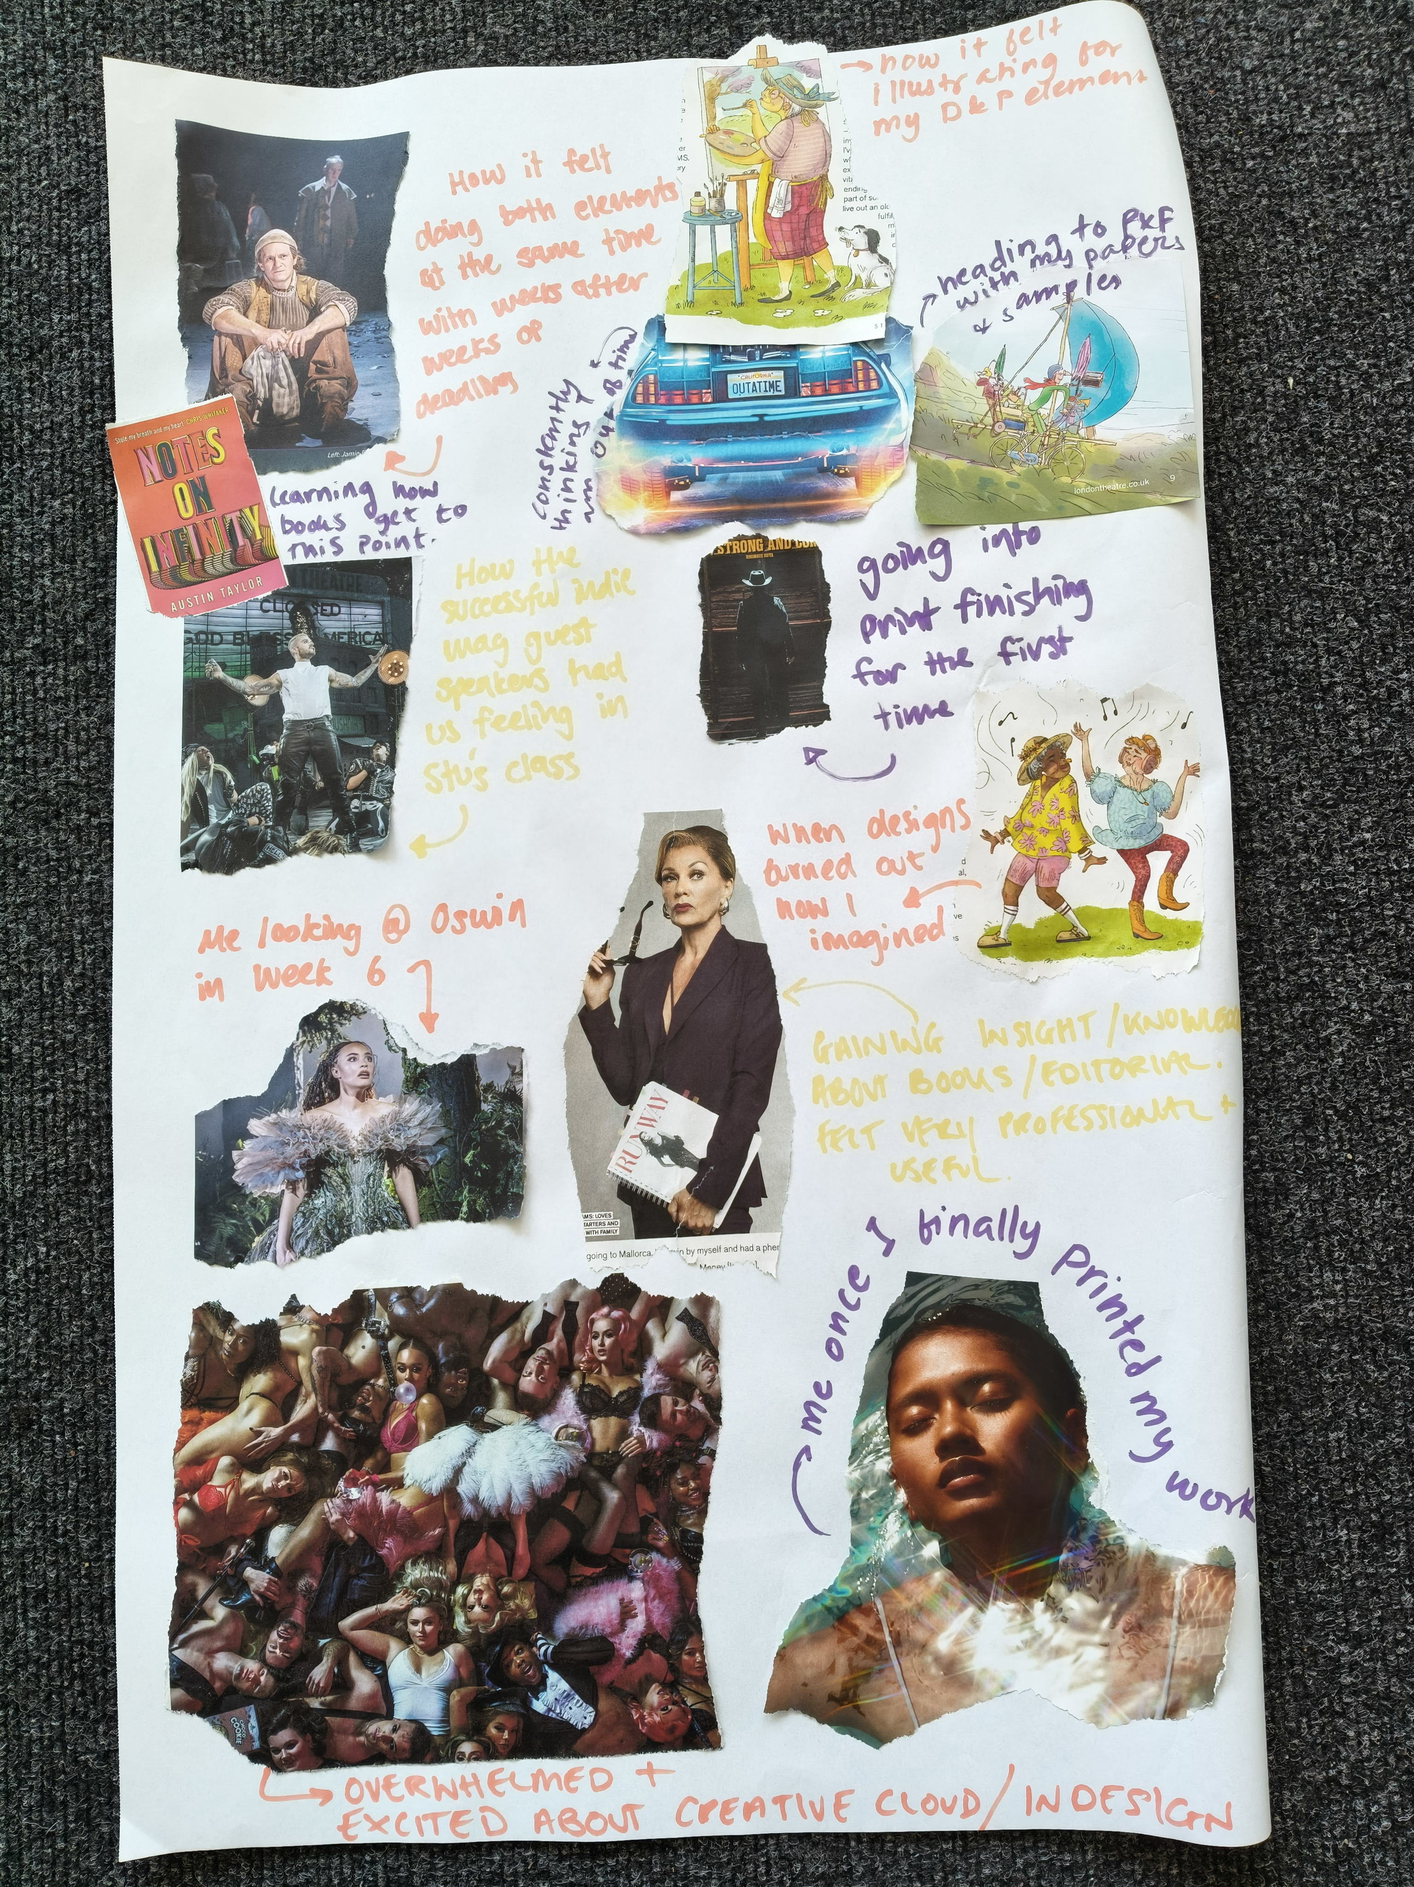
1. Collaging
15 mins – 5 mins feedback time
Question – reflect on the memorable moments from today so far?

Slide 12
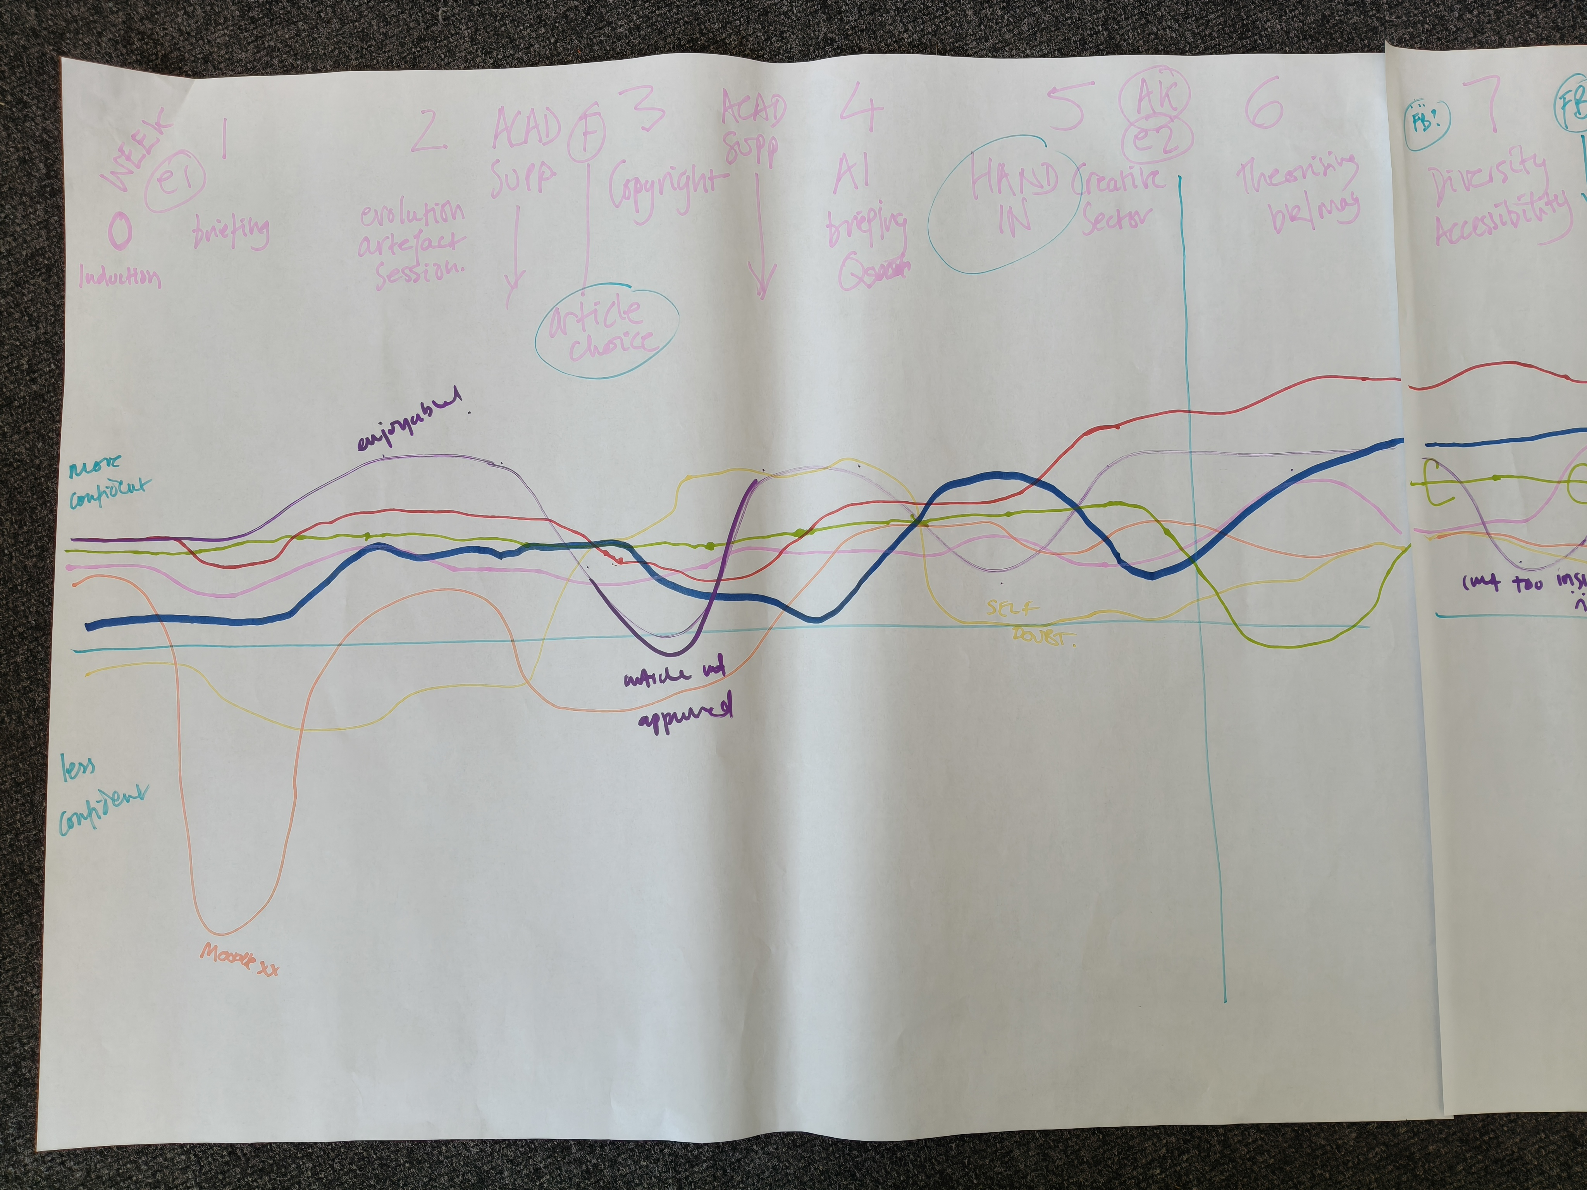
2. Collaborative emoji mapping
10 mins – 5 mins feedback
Reflecting on one academic cycle – we will explore the flow of the year and identify everyone's different high points and pain points over the course of the year

Slide 13
Physical 5
10 mins
Likert – 1-5 scales
Q1
On a scale of 1-5 where would you place the quality of the lunch?
Discuss why you have chosen this area with the people on your part of the scale – be ready to feedback

Slide 14
Quick fire last question
Q2
How likely are you likely to physical 5?

Slide 15
And one more thing – 'wish you were here?'
Please write on the post card what you would say about the workshop

Slide 16
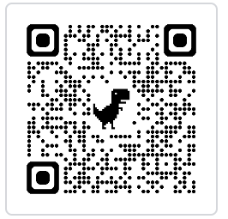
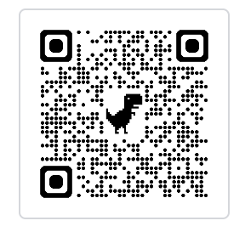
Collaboration
blog
We very interested in collaborating and are building a network – exploring creative inclusive evaluation
Resource: https://positiveevaluation.myblog.arts.ac.uk/wp-admin/
Podcast case study: https://positiveevaluation.myblog.arts.ac.uk/podcast/
podcast

Slide 17
Thank you
Dr Rose Thompson – r.thompson@arts.ac.uk
Dr Frania Hall – f.hall@lcc.arts.ac.uk
https://positiveevaluation.myblog.arts.ac.uk/

