Slide 1
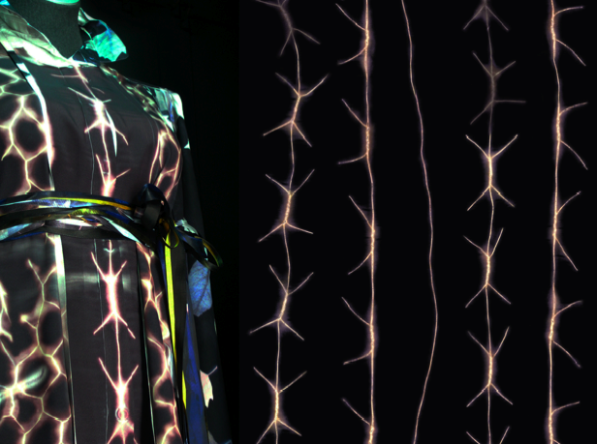
Ever & Again: Rethinking Recycled Textiles October 2005 - January 2010 Concept This AHRC funded project aims to investigate textiles recycling, looking to the textile design practitioner to propose significant change through the creation of high quality artefacts, exploring ideas about the use of new engineering technologies, long life / short life textiles, ethical production, and systems / services Stage 1: October 2005 - December 2006 To explore UK textiles recycling, the 4 design strategies, and synergies through workshop scenarios Stage 2: January 2007 - December 2007 To develop individual design projects through workshop scenarios and produce prototypes for exhibition Stage 3: January 2008 - January 2009 To redesign and ‘improve’ prototypes through workshop scenarios and present results at symposium event Final Outcomes - 2009/2010 Publish ‘Upcycling Textiles’ report. Individual researchers to further develop prototypes and/or future projects
Top 100 shirt collected by the Museum at FIT, New York, 2010. Exhibited in the Eco Fashion: Going Green show, 2010.

Slide 2
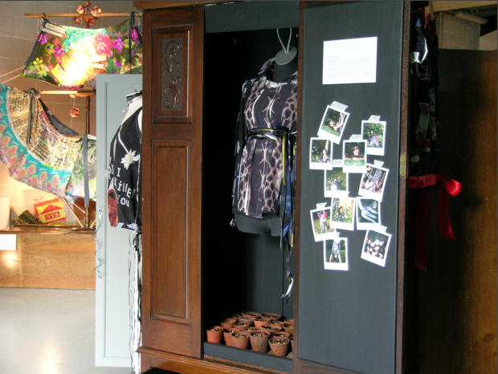
Part 2: Ever & Again: Rethinking Recycled Textiles (2005 - 2009)
Ever & Again: Experimental Recycled Textiles. Triangle Gallery, London (15 – 27 October 2007)

