Slide 1
Collecting and using artists’ moving image in academic art libraries
Artists' film: ARLIS UK & Ireland half-day workshop for art librarians and archivists
LUX, Shacklewell Studios
2 March 2011
Gustavo Grandal Montero
Collection Development Librarian, Chelsea College of Art & Design / Camberwell College of Arts

Slide 2
Collection development and management
Overview:
Selection and acquisition
Cataloguing and access
Use and legislation
Preservation
Notes:
Overview of the presentation, focusing on practical issues for librarians

Slide 3
Selection and acquisition
Artists’ films and videos can be available as:
limited edition artworks, often numbered and/or signed, normally acquired with public performance and other rights
institutional copies in professional (e.g. Betacam, Digital Betacam) or domestic formats (VHS, DVD) for viewing, public performance, or institutional collection
mass-market releases on commercial formats (VHS, DVD, Blu-Ray) for ‘domestic use’
television programmes
online streamed videos (from low quality illegal copies to HD)
Notes:
Variety of formats
1971 Sony ¾” U-matic
1975 Sony ½” Betamax, the first videocassette aimed at the home market
1976 JVC VHS (Video Home System), which eventually emerged as the preferred consumer format in the early 1980s
1995 DVD (Digital Video Disc), it has replaced VHS as the universal format for home video
2006 Blu-Ray Disc (BD) next generation digital format
1990s- Online streamed content
Television (BBC, ITV, Channel Four, E4, More 4, Film 4, and Five Television with ERA Licence)
CHELSEA
Ca. 2,000 DVDs, 1,000 VHS, 100 U-matic videocassettes, 5 Digibeta tapes.
Majority pre-recorded commercial publications, but with a significant number of television programmes recorded off-air. Some original material acquired through donation.

Slide 4
Selection and acquisition 2
Publishers and distributors:
artists themselves
artists’ organisations and centres: Art Metropole, Electronic Arts Intermix, Lux, Printed Matter, etc.
public galleries and art agencies: Artangel, Arts Council, Baltic, Bifrons Foundation, Centre Pompidou, ICA, Tate, etc.
commercial galleries
publishers of contemporary art books, artists’ books and multiples: Bookworks, Edition Fink, JRP Ringier, Les Presses du Reel, mfc Michele Didier, Onestar Press, etc.
Art bookshops: Artwords, Boekie Woekie, Florence Loewy, etc.
Notes:
Acquiring this material could be difficult and time consuming, for reasons that include the lack of specialist library suppliers, limited availability of historical and back catalogue titles, changing and diverse formats, complex legal frameworks, etc.
This is also due in part to the nature of the material itself, that of an art work. As with artists’ books, prints or multiples, the librarian working with artists’ moving image assumes the role of the curator.
Issues to explore: Purchase vs Donation; Viewing copies/renting/purchase

Slide 5
Selection and acquisition 3
Publishers and distributors:
artists’ film and video specialist distributors/publishers: Anarchive, Anthology Film Archives, Artpix, BDV, Canyon Cinema, Center for Visual Music, CFMDC, Cinenova, Film and Video Umbrella, Filmarmalade, Heure Exquise!, Index, Light Cone, Lowave, Mystic Fire, Re:voir, Sixpackfilm, The Film-Makers’ Cooperative, V tape, Video Data Bank, etc.
mainstream film and video distributors: Artificial Eye, BFI, Facets, First Run, Palm Pictures, Tartan, T&C Film, etc.
specialist video shops: Close-up
Notes:
Publishers and distributors 2
Online generalist video suppliers (Amazon, Moviemail, etc.) only offer a very small percentage of the material available

Slide 6
A few selected suppliers
BDV (Bureau des videos) (France)
http://www.bureaudesvideos.com
Cinenova (UK)
http://www.cinenova.org.uk
Canyon cinema (USA)
http://www.canyoncinema.com
Electronic Arts Intermix (USA)
http://www.eai.org/eai/index.htm
Video Data Bank (USA)
http://www.vdb.org
V tape (Canada)
http://www.vtape.org
Notes:
Distributors of copies
BDV (Bureau des videos) (France)
http://www.bureaudesvideos.com
Contemporary video art distribution and publishing company created in 1994. Limited editions on professional formats include public performance rights. Unlimited editions on VHS and DVD for private use only are also available for sale. Catalogue available online.
Canyon cinema (USA)
http://www.canyoncinema.com
Filmmakers' cooperative specialising in the distribution of experimental film, founded in 1967. Collection of more than 3500 films available for rental and sale in different formats, including VHS and DVD. Catalogue available online.
Cinenova (UK)
http://www.cinenova.org.uk
Non-profit organisation dedicated to distributing films and videos made by women, formed in 1991. Collection in different formats, including VHS and DVD, available for rental and sale. Catalogue available online.
Electronic Arts Intermix (USA)
http://www.eai.org/eai/index.htm
Non-profit media arts centre and distribution service for video and media art, founded in 1971. Collection of 3000 works available for rental or sale in different formats, including on DVD for educational use in libraries or classrooms. Catalogue available online.
Video Data Bank (USA) [Online and DVD publishing]
http://www.vdb.org
Distribution service for video art, established in 1976. Collection of 1600 works available for rental and sale in different formats, including VHS and DVD. Its Early Video Art collection includes many titles from the Castelli-Sonnabend collection, the first and most prominent collection of late 60s and 70s video art. Catalogue available online.
V tape (Canada)
http://www.vtape.org
Arts center and distribution service for video and media art, founded in 1980. Collection of 3500 works available for rental and sale in different formats, including DVD. Catalogue available online.

Slide 7
A few selected suppliers 2
Filmarmalade (UK)
http://www.filmarmalade.co.uk
Index (Austria)
http://www.index-dvd.at/en/index.html
Lowave (France)
http://www.lowave.com
Lux (UK)
http://www.lux.org.uk
Re:voir (France)
http://www.re-voir.com
Notes:
Publishers of commercial DVDs
Filmarmalade (UK)
http://www.filmarmalade.co.uk
New publisher of contemporary artists’ film and video. Each DVD release includes a single work, published as a limited edition. Catalogue available online.
Index (Austria)
http://www.index-dvd.at/en/index.html
Publisher of Austrian and international film, video and media art on DVD, established in 2004. Catalogue available online.
Lowave (France)
http://www.lowave.com
Publisher of contemporary film and video art on DVD, established in 2002. Catalogue available online.
Lux (UK) [Also distributor and online content]
http://www.lux.org.uk
Non-profit arts agency for the support and promotion of artists’ moving image. Founded in 2002, it builds on four decades of work by predecessor organisations (The London Filmmakers Co-operative, London Video Arts and The Lux Centre). Collection of 4500 works available for rental and sale in different formats, including DVD. It also publishes the collection Afterimages and anthologies on DVD. Catalogue available online.
The Lux shop is an excellent source of commercially published VHS and DVD titles.
Re:voir (France) [Online]
http://www.re-voir.com
Publisher of artists’ film and video on VHS and DVD, established in 1994 as Light Cone Video. Catalogue available online.

Slide 8
Television and some online sources
Television
ERA Licence: BBC, ITV, Channel Four, E4, More 4 and Film 4, and Five Television.
BUFVC Off-Air Recording Back-Up Service
Online
Arts on Film Archive, University of Westminster (Arts Council Documentary Film Collection) http://artsonfilm.wmin.ac.uk
Instant Cinema http://instantcinema.org
Lux Online http://www.luxonline.org.uk
Tate Channel http://channel.tate.org.uk/channel/films-by-artists
UbuWeb http://www.ubu.com/film
Vimeo, YouTube, etc.
Notes:
Television
ERA License: Permits staff at British educational establishments to record, for non-commercial educational purposes, scheduled free-to-air broadcasts on BBC television and radio, ITV Network services, Channel Four, E4, More 4 and Film 4, and Five Television. Strict terms and conditions regulate use, labelling, retention, making of copies, etc. More information is available at: http://www.era.org.uk.
BUFVC TRILT, Off-Air Recording Back-Up Service and BoB National http://bufvc.ac.uk/tvandradio
Email lists
Online artists’ moving image
Growing variety of sources… quality and legal issues may be a problem, particularly with media ‘sharing’ websites

Slide 9
Selection and acquisition 4
Other sources of information for selection and acquisition:
Lux and British Artists' Film and Video Study Collection…
REWIND http://www.rewind.ac.uk/rewind/index.php/Welcome
Find DVD / HERMES db http://www.bufvc.ac.uk/hermes
Art magazines and listings: Art Monthly, Artforum, etc.
Specialised galleries: e.g. No.w.here http://www.no-w-here.org.uk
Online resources: e.g. Video History Project Http://www.experimentaltvcenter.org/history/index.html
Notes:
FORTHCOMING (2012): The Moving Image Review & Art Journal (MIRAJ) http://www.intellectbooks.co.uk/journals/view-Journal,id=207

Slide 10
Cataloguing and access
consistency in the application of international standards (e.g. AACR2, MARC21, DDC, LCSH, etc.)
local guidelines for the cataloguing of video recordings (and artists’ multiples for some of these items)
editing of derived records
relevant and consistent selection of access points
relevant and consistent subject and genre indexing
loan vs. reference use: purchase licence conditions and other legal requirements, maximising access to expensive resources, preservation, etc.
Closed access? Special Collection?
Notes:
Cataloguing in the context of a LMS:
Records should be created and/or edited by staff with specialist knowledge
Consistency is also a crucial element in creating good catalogue records that facilitate access to these materials

Slide 11
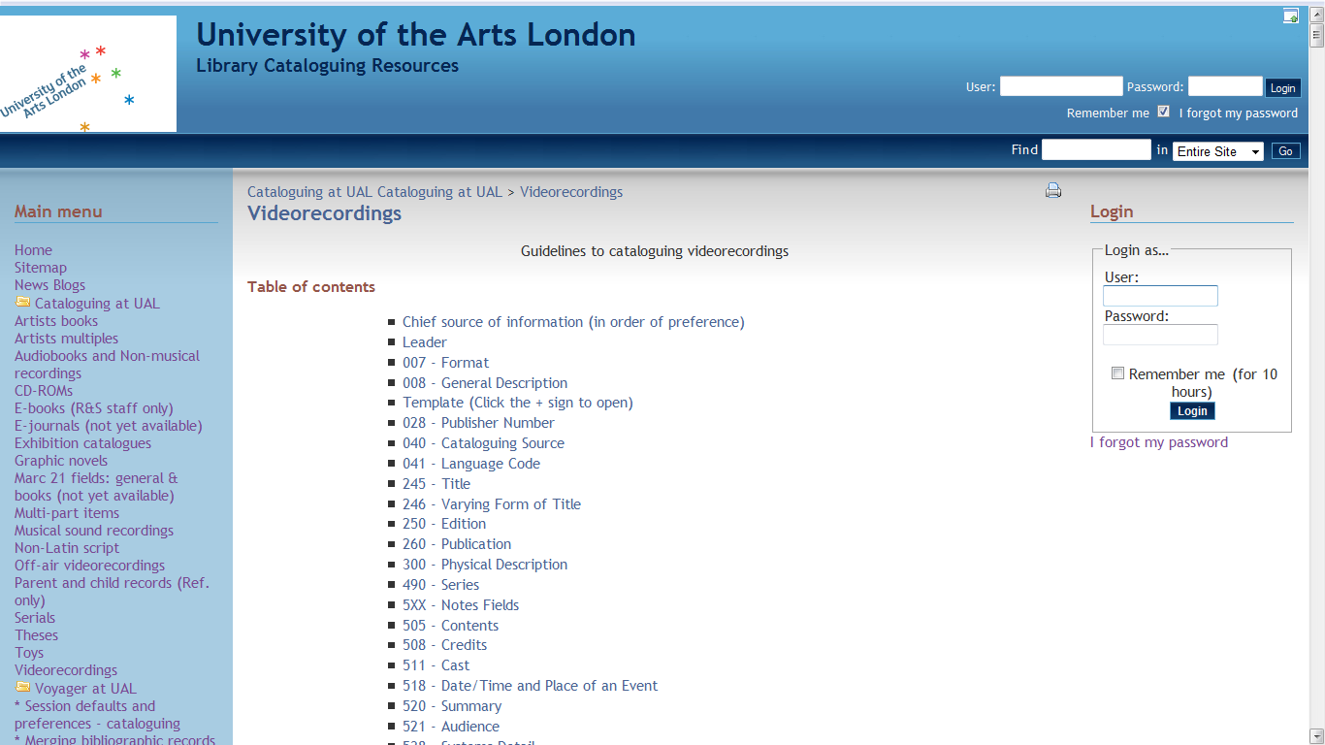
Cataloguing and access 2
Notes:
UAL guidelines for cataloguing videorecordings

Slide 12
Use and legislation
Copyright:
Films, videos and television programmes are protected by copyright legislation. In the UK, commercially produced video on any format (including VHS and DVD) can be shown for teaching purposes, as long as the audience consists of registered students only. Copying and adapting this material is not allowed without the permission of the copyright owner. The director and producer are the principal joint owners of copyright, and other people may own the copyright in parts of the programme, e.g., the screenplay or the music. If a programme is produced for an employer, copyright is owned by the employer. Copyright of a film lasts for 70 years after the death of the director, producer, screenwriter and composer of any original music.
Notes:
Although videos have been part of library collections for more than 30 years, the use of this format in academic institutions still presents a number of challenges, with a complex legal framework that includes several grey areas. The brief information provided in this section is intended for general guidance only and individual institutions should establish clear and comprehensive policies and guidelines informed by professional legal advice to ensure that their practices stay within the law. The BUFVC (British Universities Film and Video Council) provides advice to its members on all aspects of audiovisual collection management and usage.
Copyright is possibly the most important and most complex of the legal issues related to this material.

Slide 13
Use and legislation 2
Copyright :
Copyright on television programmes expires after 50 years.
Non-commercially produced videos are also protected by copyright. The conditions in which they can be used depend on the terms of the acquisition, and can be subject to a written contract.
Artists’ film and video public performance, display and other rights are often offered for sale for institutions (including libraries), and can occasionally be a compulsory requisite for purchase.
Notes:
Copyright 2

Slide 14
Use and legislation
Censorship:
The Video Recordings Act 1984 introduced compulsory video censorship in the UK. Since 1985, the supply of videos not classified by the BBFC (British Board of Film Classification) is a criminal offence, unless exempt, as is supplying a rated video to anyone under the age stated. The interpretation of the law to establish what material is not covered by it requires subjective judgement, and should only be applied in the context of institutional policies and guidelines.
Off-air recordings made under the ERA Licence are not covered by this law (as television programmes are regulated by OFCOM).
Notes:
Censorship is also a very important legal consideration, particularly in the UK, where the Video Recordings Act 1984 introduced compulsory video censorship. The Video Standards Council, the UK’s video industry professional body, has produced a very clear guide to the Video Recordings Act and subsidiary legislation, which is available at: http://www.videostandards.org.uk
Exemptions:
A video is not covered by the Act and is exempt from classification if it is considered educational or if its subject is sport, religion or music. However, this exemption is only granted if the video does not contain images of human sexual activity; mutilation, torture or other acts of gross violence towards humans or animals; human genital organs or human urinary or excretory functions; or techniques likely to be useful in the commission of offences.

Slide 15
Preservation
Archival role?
most academic libraries have no formal archival role in this area
a typical academic AV collection comprises mostly commercial pre-recorded VHS tapes and DVDs, and off-air recordings on both formats
However, there is need to ensure that these materials are available for future use in teaching and research, and
some material may be difficult to find or access in other public collections
some older commercial material or off-air recordings may be or become rare or even unique (and it is difficult to identify as such)
some collections include rare or unique copies of non-editioned original works made by the artists, on a variety of formats (e.g. degree showreels)
Notes:
No national film and/or video catalogue: BFI, COPAC, AIM25, etc.
BUFVC National register of off-air recordings

Slide 16
Preservation 2
VHS and DVD were not designed as long term archival formats:
migration of material to new copies, when legal (e.g. transferring VHS off-air recordings to DVD), and substitution of commercially available titles, when practicable, are partial remedial solutions.
Equipment and format obsolescence pose a greater threat to video collections than media degradation factors:
need for dedicated equipment for different formats and the pace of technological change could mean that in the long term video collections on cassette or disc formats will not be sustainable.
Notes:
National Preservation Office has published practical guidelines for libraries on Caring for CDs and DVDs, available at http://www.bl.uk/npo/pdf/cd.pdf.
The Association of Moving Image Archivists (AMIA) has developed similar guidelines for videotapes, Videotape preservation fact sheet, available at http://www.amianet.org/resources/guides/fact_sheets.pdf.

Slide 17
Preservation 3
Future?
For many years now (1990s-) the consensus principle for long term video preservation is that efforts must concentrate on the content, which can only be preserved by migration from analogue to digital formats (which in the case of material under copyright can only be achieved with the explicit agreement of the copyright holder).
Digitisation? In house, cooperative projects, commercial digitisation services, third party online providers…
Notes:
REWIND partnership at Chelsea

Slide 18
Very brief bibliography Cooke, J. (2009) Cataloguing artists’ videos, ‘Art Libraries Journal’, vol. 34 no. 3., pp. 40-45. Grandal Montero, G. (2009) Video as art: collecting artists’ moving image in academic art libraries, ‘Art Libraries Journal’, vol. 34 no. 3., pp. 5-10. Marine, S. (2010) Cataloguing artists' moving image at Chelsea College of Art and Design Library, ‘Catalogue & Index’, no. 159, pp. 10-12. McKie, A., Trumper, J., and Turner, N. (2004) Diverse practices: video art and libraries, ‘Art libraries journal’ vol. 29 no. 1, pp. 35-41.
Notes:
End. Thanks.

